Slide 1
ISAS CMS training

Slide 2
CMS – Content Management System
A web content management system is a software system that provides website authoring, collaboration, and administration tools designed to allow users with little knowledge to create and manage website content with relative ease.
Most systems use a content repository or a database to store page content, metadata, and other information assets that might be needed by the system.
We are using web content management system for ISAS.

Slide 3
Permissions
Full Control - Contains all available SharePoint permissions. By default, this permission level is assigned to the Owners group. It can’t be customized or deleted.
Contribute - View, add, update, and delete list items and documents.
Approve – have access to approve the items.

Slide 4
Add Item to the ISAS Events list
Open the site by following the link : http://admin-isas.nus.edu.sg/_layouts/15/viewlsts.aspx
On prompt, please provide the credentials -> Ok.
Select ISAS events list.
Click on new item - > Provide the values
To select Image, click on ‘Click here to insert picture from SharePoint’.
Browse for the image -> select -> Ok
Update the fields -> Save.

Slide 5
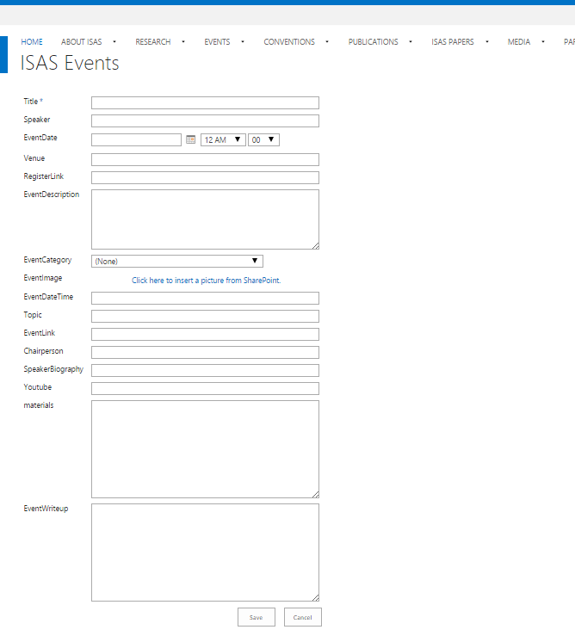

Slide 6
Edit list item ISAS events
Open the site by following the link :
http://admin-isas.nus.edu.sg/_layouts/15/viewlsts.aspx
On prompt, please provide the credentials -> Ok.
Select ISAS events list.
Click on item to be edited -> right click -> select edit item
Update the fields -> Save

Slide 7
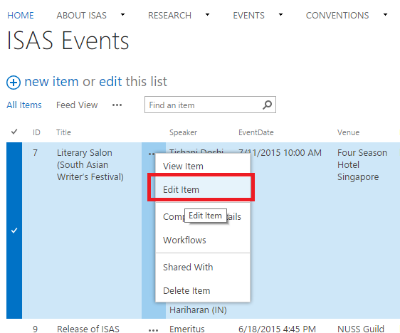

Slide 8
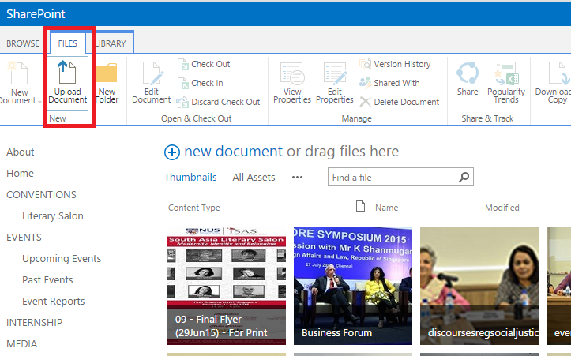
Add Image(s) to the ISAS site
Open the site by following the link : http://admin-isas.nus.edu.sg/_layouts/15/viewlsts.aspx
On prompt, please provide the credentials -> Ok.
Select Images.
Select the respective folder -> Select File -> Upload document on ribbon menu -> browse for image -> Ok.

Slide 9
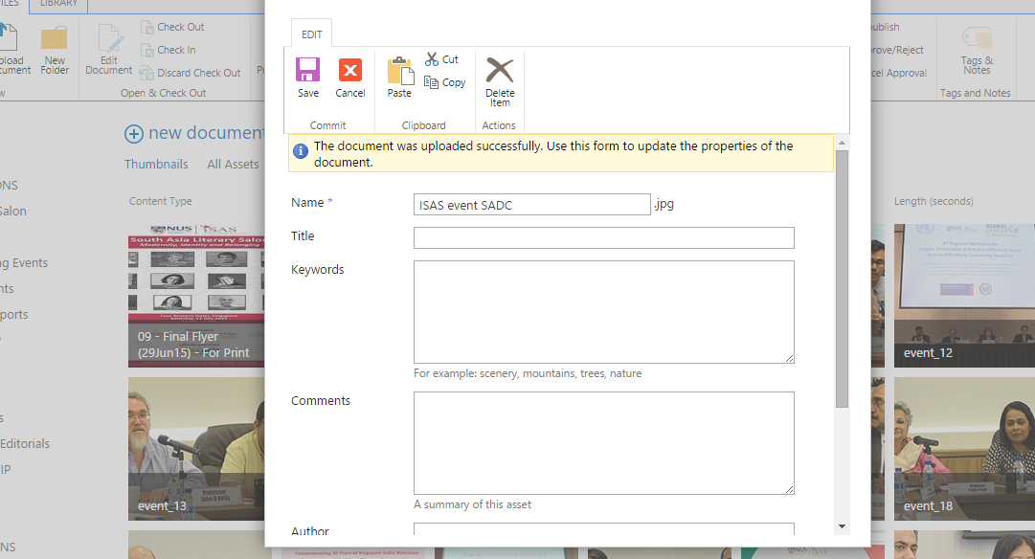
Click on Save to add Image to the Image library.

Slide 10
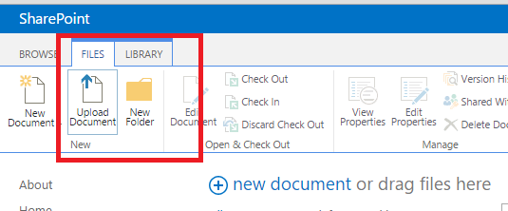
Add / Update item to ISAS Papers
Open the site by following the link : http://admin-isas.nus.edu.sg/_layouts/15/viewlsts.aspx
On prompt, please provide the credentials -> Ok.
Select ISAS Reports list.
On top ribbon menu, select Files -> Upload document.
Browse for the document to be uploaded -> click on Ok.
After document uploaded, update the meta data -> Save.

Slide 11
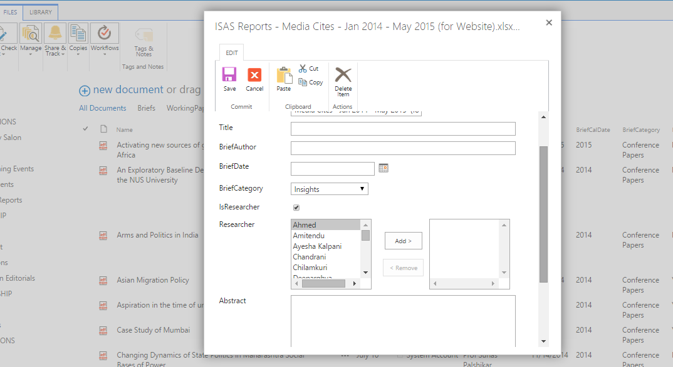

Slide 12
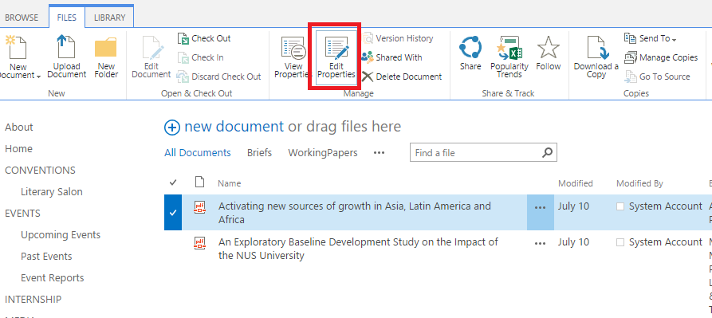
Update item for ISAS papers
Open the site by following the link :
http://admin-isas.nus.edu.sg/_layouts/15/viewlsts.aspx
On prompt, please provide the credentials -> Ok.
Select ISAS Reports list.
Select item to be edited -> select edit properties. -> update the content -> Save.

Slide 13
Add / Update items for Publications
Open the site by following the link :
http://admin-isas.nus.edu.sg/_layouts/15/viewlsts.aspx
On prompt, please provide the credentials -> Ok.
Select Publications list.
Click on new item - > Provide the values
To select Image, click on ‘Click here to insert picture from SharePoint’.
Browse for the image -> select -> Ok
Update the fields -> Save.

Slide 14
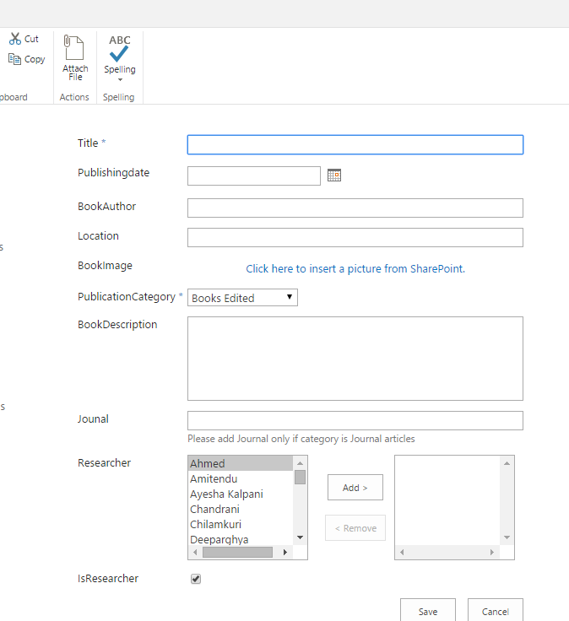

Slide 15
Edit item in publications list
Open the site by following the link :
http://admin-isas.nus.edu.sg/_layouts/15/viewlsts.aspx
On prompt, please provide the credentials -> Ok.
Select publications list.
Click on item to be edited -> right click -> select edit item
Update the fields -> Save.

Slide 16
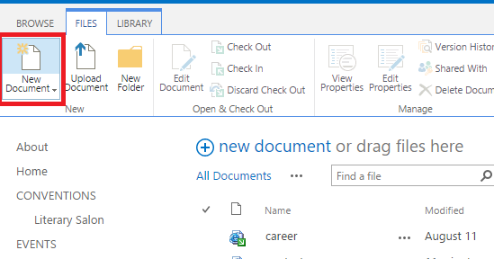
Add new page to the site
Open the site by following the link :
http://admin-isas.nus.edu.sg/_layouts/15/viewlsts.aspx
On prompt, please provide the credentials -> Ok.
Select Pages library
Under top ribbon menu bar -> select files -> New document.
Provide values along with layout as ISAS_ContentPageLayout - > Create.

Slide 17
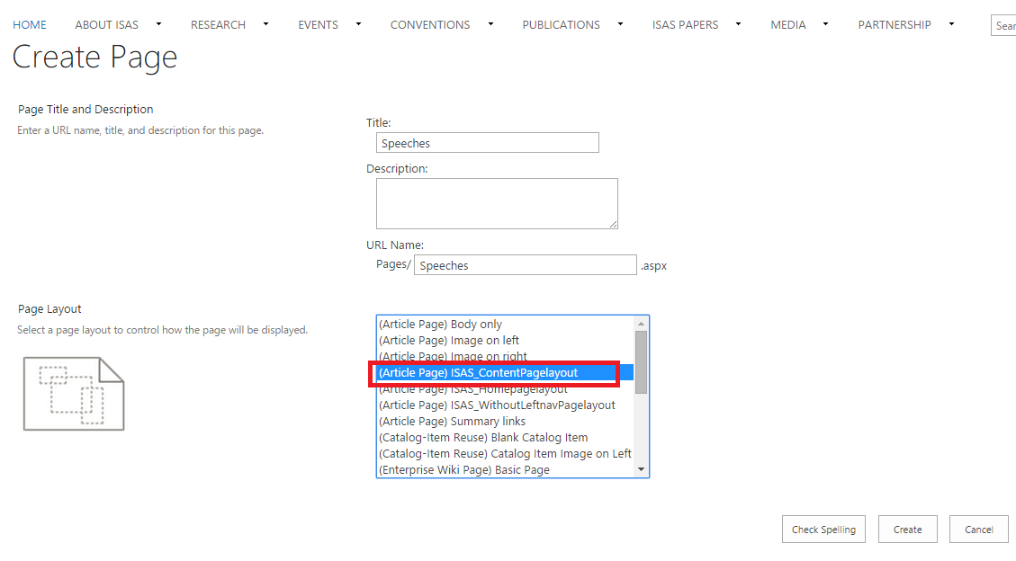

Slide 18
Edit the content on the page
Open the site by following the link : http://admin-isas.nus.edu.sg
On prompt, please provide the credentials -> Ok.
Select the Introduction page from top navigation.
On top right corner of the page, click on settings icon ->edit page.

Slide 19
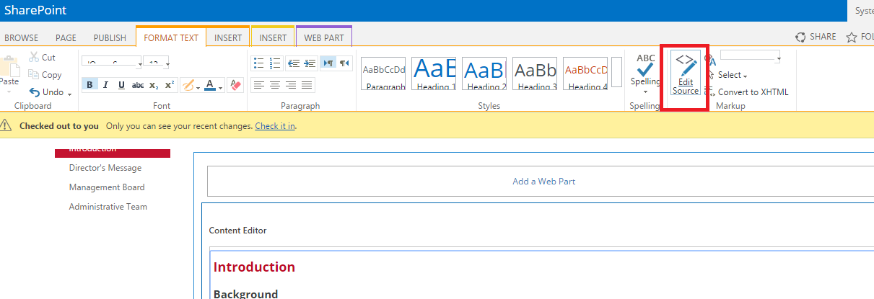
Select the webpart -> on ribbon menu - > edit source
Edit the content -> Ok
On top ribbon menu, select Check in.
On Pop up select Continue to save the changes.

Slide 20
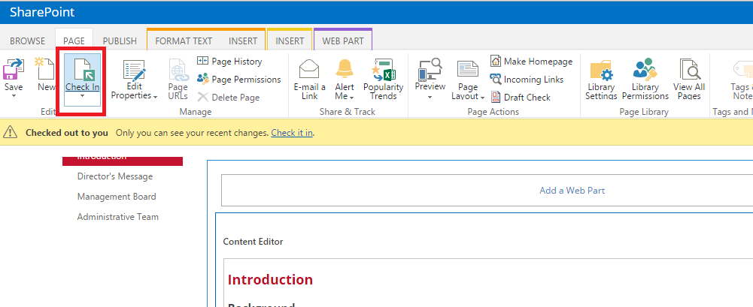
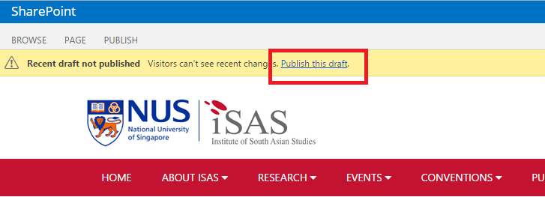
Click on Publish this draft link to publish the page.

